Slide 1
Features : relevant + Keeping the customer on the app
Prob that will transact
Use + paid
Ads –revenue
Data captured
HI / LI
Involving cusomers ( CE HIIGH ….. Involvement is high)
Ask the cust to review the pdt

Slide 2
Customer Engagement

Slide 3
Customer Engagement vs Customer Experience Are the different / same

Slide 4
“Most companies must realize that they are no longer competing against the guy down the street or the brand that sells similar products. Instead, they’re competing with every other experience a customer has.”
- DAN GINGISS, AUTHOR AND CUSTOMER EXPERIENCE EXPERT

Slide 5
“Customers have so much power now. The rewards of harnessing your most ardent fans are amazing, but customers will also be very vocal when they are displeased. Knowing your customers and understanding their needs has become critical to success, no matter what industry you’re in.”
- NEERACHA TAYCHAKHOONAVUDH, EVP OF INDUSTRIES AT SALESFORCE

Slide 6
Customer Engagement
Customer engagement is delivering connected experiences to your customers instead of single, one-off, or fleeting transactions. It means optimizing your team structure, operations, and technology to create a connected feedback loop with customers. Businesses need to stay informed about customers’ evolving needs, maintain and build their brand integrity, and make ethical use of customer data to help customers have the best experience.

Slide 7
Personalized customer engagement relies on an integrated tech stack. For example, a connected CRM gives your company a single, 360-degree view of every customer. With this insight, your teams can use data to tailor content and experiences to your customers’ unique needs, and help your brand keep pace with rising customer expectations.

Slide 8
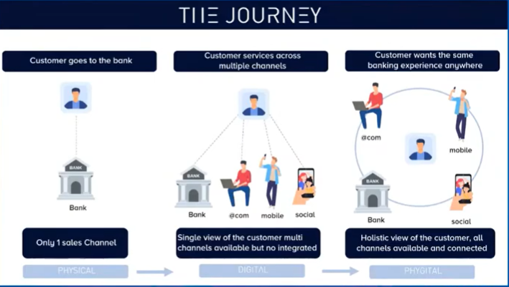
Banking sector : Applicable to other sectors as well

Slide 9
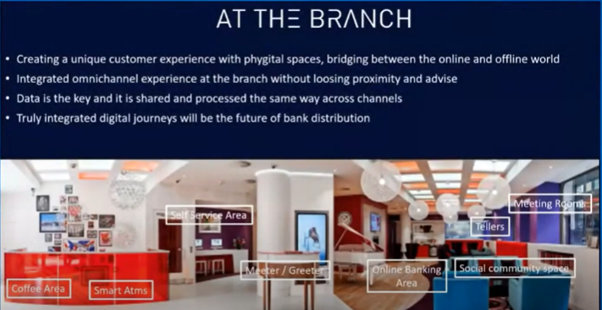

Slide 10
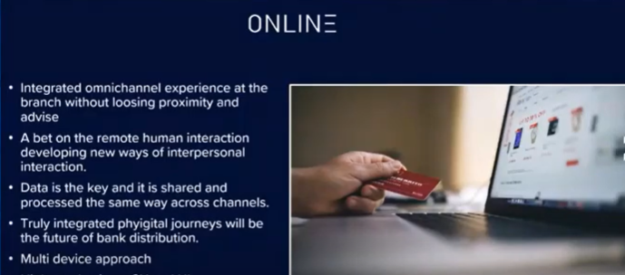

Slide 11
research found that 80% of customers say the experiences provided by a company are as important to them as its products and services
Core
Peripheral

Slide 12
https://www.youtube.com/watch?v=mfqjchxc4TA
https://www.youtube.com/watch?v=zRk7pZwI4fQ

Slide 13
Measuring customer engagement isn’t always easy.
Is a customer who visited your website 10 times last week more engaged than one who spent 15 minutes talking to a sales rep on the phone?
Is a new customer who made five recent purchases more engaged than a long-time customer who only buys once a year?
Do your answers to these questions change if one customer completes an online survey or recommends your brand to others?

Slide 14
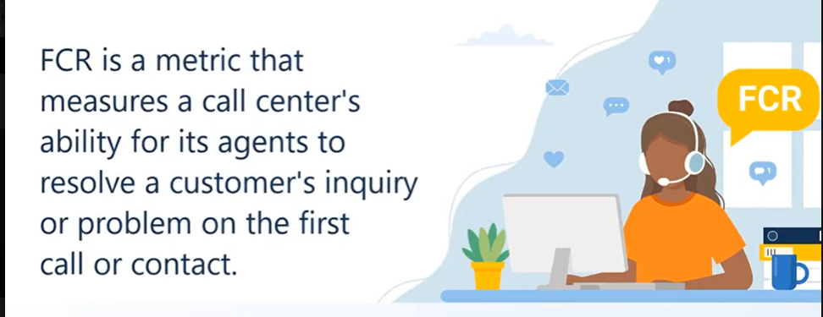
1. First Call Resolution rate is one of the indicators when call centers come into the picture
First call resolutions

Slide 15
Ref page
https://www.sqmgroup.com/resources/library/blog/fcr-metric-operating-philosophy#:~:text=The%20First%20Call%20Resolution%20industry,the%20World%2DClass%20FCR%20Rate.

Slide 16
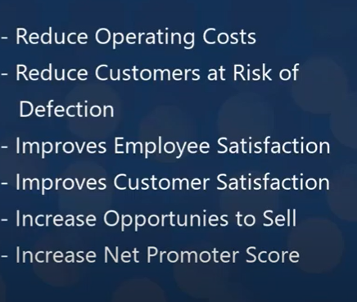
Benefits

Slide 17
There are many challenges to improving the First Call Resolution rate
three main sources of errors (SOE) that hinder a high FCR rate:
38% are due to agent mistakes,
13% are due to miscommunication by the customers,
and 49% are because of organizational policies and procedures

Slide 18
top five repeat call reasons that hinder a high FCR rate and great customers service are:
A customer needed to verify or check the status of their unresolved issue
While the customer was on hold, they got disconnected
Agent lacked the knowledge to resolve the issue
The customer request was not done
The customer was redirected to a 3rd party

Slide 19
six benefits for measuring and increasing the First Call Resolution rate are the following:
For every 1% improvement in FCR, you reduce your operating costs by 1%.
95% of customers will continue to do business with the organization due to achieving FCR.
For every 1% improvement in FCR, there is a 1% improvement in customer satisfaction.
For every 1% improvement in FCR, there is a 1% to 5% improvement in employee satisfaction.
When a customer's call is resolved, the cross-selling acceptance rate increases by 20%.

Slide 20
2. Customer Engagement
Online and Offline
https://clevertap.com/blog/offline-online-customer-engagement/

Slide 21
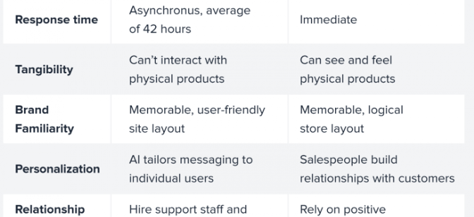
Online Offline

Slide 22






Engaging users across channels
Unify Your Data
Create Personas
Identify Your Channels
SMS notifications have a sky-high open rate of 98%, SMS messaging for online customer engagement can backfire when:*
They receive unsolicited messages: 25%
There isn’t an opt-out option: 19%
They receive too many notifications: 19%
The messaging feels spammy: 18%
Create a Consistent Cross-Channel Brand Identity
Tailor Channel Messaging
Use Marketing Automation

Slide 23
Other customer engagement metrics
https://www.dialpad.com/blog/customer-engagement-metrics/

Slide 24
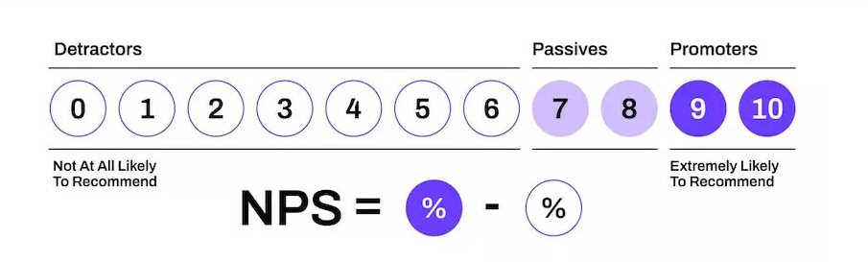
CSAT Surveys
Net Promotor score
First week engagement
Daily active users (DAU): Unique users of a product or service per day. Sometimes referred to as a “vanity metric.”
Monthly active users (MAU): Unique users visiting a site within a month.
To calculate, try this formula: DAU ÷ MAU = Stickiness.

Slide 25
Churn rate
User activity :Daily active /monthly active
Social media active metrics
Customer lifetime value
Visit frequency
Session Time
Feature Usage
Bounce rate
measures the number of visitors to your site who leave immediately without engaging in any content or features.

Slide 26
Omni Channel vs Multi channel strategy

